Slide 1


Flask: A Micro-Framework – An Advanced Python Library
A Deep Dive into Flask’s Architecture, Features, and Use-Cases
By:- Ankush Banotra
Notes:
‹#›

Slide 2

Introduction to Flask
What is Flask?
Historical Background
Community
Flask is a lightweight WSGI web framework in Python built for simplicity.
Created by Armin Ronacher in 2010 as part of the Pallets Project.
Widely used with a supportive open-source community.
Notes:
‹#›

Slide 3

Why Choose Flask?
Lightweight & Flexible
Ideal Use-Cases
Compared to Django
Minimal core with optional extensions to suit your needs.
Rapid prototyping
Less opinionated, more control, but fewer built-in features.
Microservices
Notes:
‹#›

Slide 4
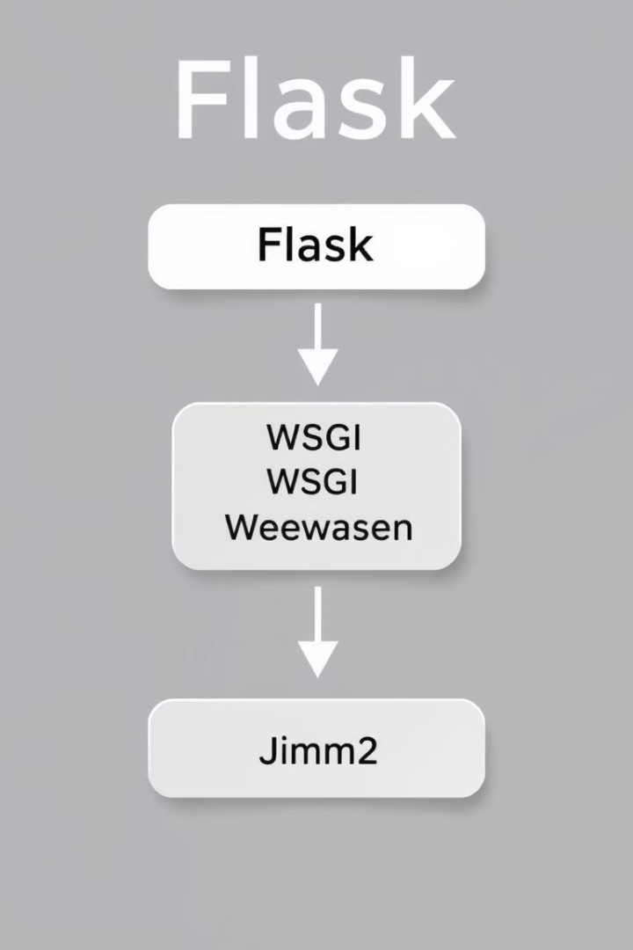
Flask Architecture Overview
WSGI
Standard interface between web servers and Python apps.
Werkzeug
WSGI utility library powering Flask's routing and request handling.
Jinja2
Powerful templating engine for dynamic HTML rendering.
Modular Design
Separates routes, views, templates, and extensions cleanly.
Notes:
‹#›

Slide 5
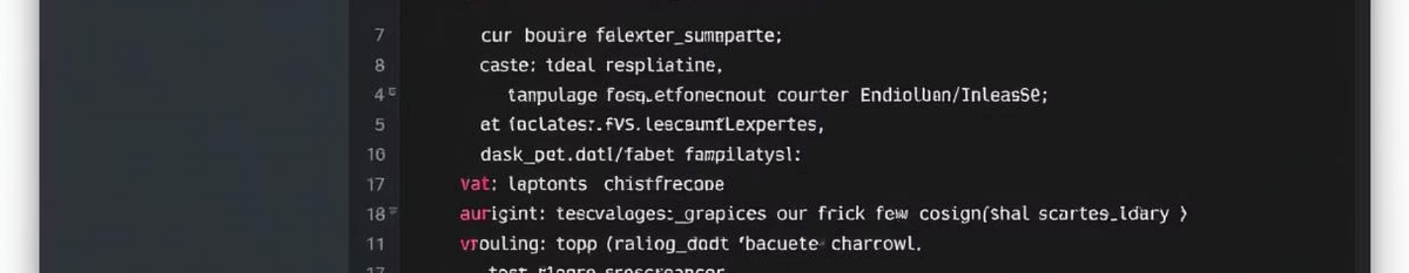




Core Features of Flask
Routing & URL Mapping
Jinja2 Template Rendering
Integrated Debugger
Database Integration
Notes:
‹#›

Slide 6
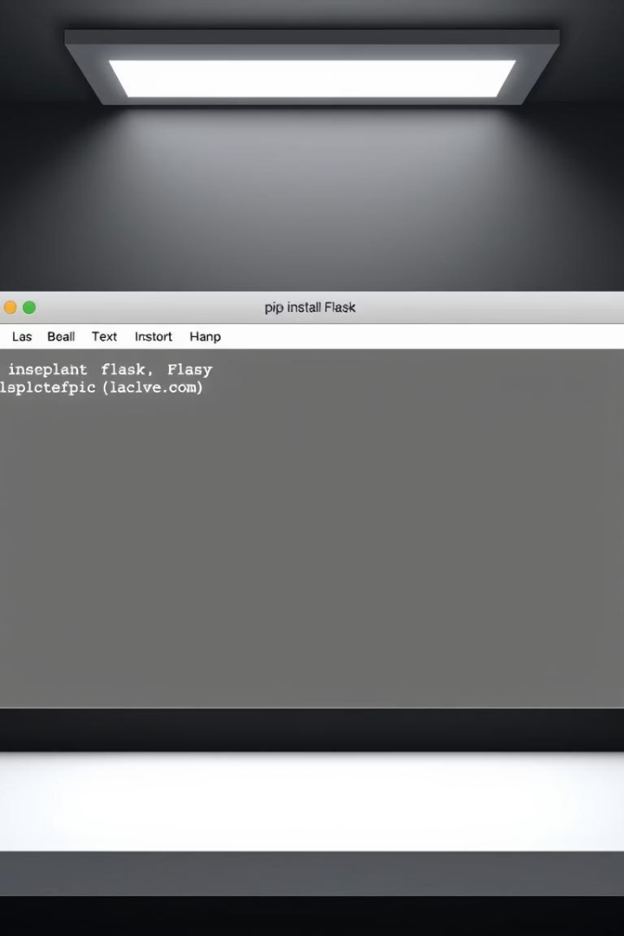




Setting Up Flask
Install Flask
Run: pip install Flask
Create Minimal App
Define app and route with basic "Hello, Flask!" function.
Run Server
Execute app to launch development server locally.
Notes:
‹#›

Slide 7

URL Routing and View Functions
Example
Dynamic Routes
@app.route('/user/<username>') returns user-specific content.
Routing Concept
Use parameters with syntax<variable_name> for flexibility.
Link URLs to Python functions (view handlers).
Notes:
‹#›

Slide 8
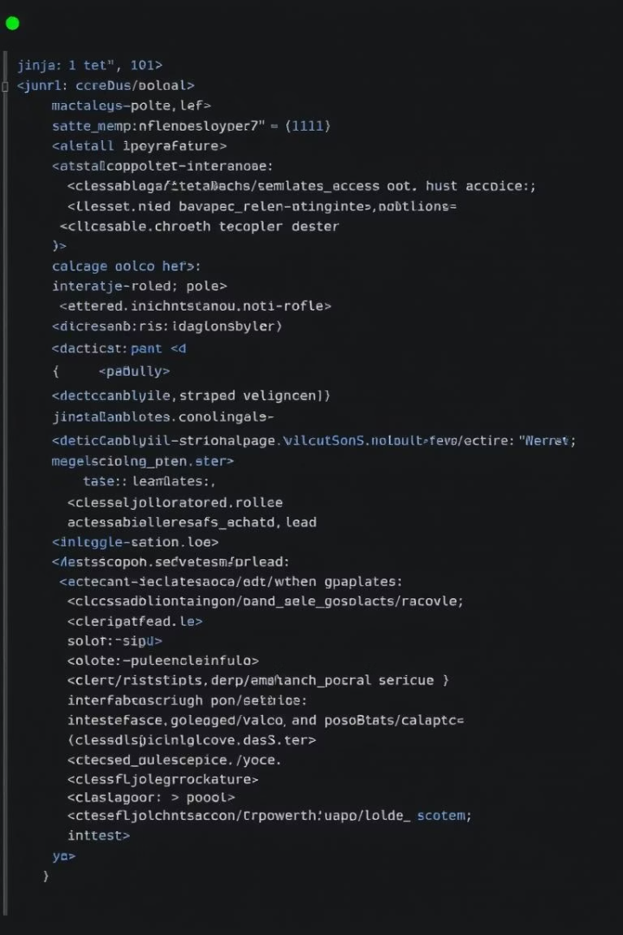
Working with Templates in Flask
Jinja2 Syntax
render_template()
Use double curly braces {{ }} for variables and control structures.
Function to render templates passing data from views.
Template Inheritance
Extend base templates for reusable UI components.
Notes:
‹#›

Slide 9
Flask Request and Response Objects
Request Object
Response Object
Example Usage
Access GET/POST data, headers, and form inputs easily.
Customize HTTP headers, status codes, and response content.
Retrieve form data: request.form['username'] in view functions.
Notes:
‹#›

Slide 10

Extending Flask with Extensions
Flask-SQLAlchemy
Object-relational mapper for database integration.
Flask-WTF
Form handling with CSRF protection and validation.
Flask-Login
User authentication management made simple.
Benefits
Enhance Flask without inflating its core size or complexity.
Notes:
‹#›

Slide 11

Exploring Flask: Extensions, APIs, and Use Cases
Flask is a lightweight Python web framework favored for its flexibility and simplicity. This presentation covers essential extensions, REST API creation, practical use cases, evaluation of strengths and weaknesses, and resources for deeper learning.
Notes:
‹#›

Slide 12

Key Flask Extensions
Flask-SQLAlchemy
Provides ORM capabilities to simplify database interactions within Flask apps.
Flask-WTF
Facilitates secure and easy form handling with CSRF protection support.
Flask-Login
Manages user sessions and authentication workflows seamlessly.
Extensibility
Flask extends functionality without bloating its core architecture.
Notes:
‹#›

Slide 13


Building REST APIs with Flask
API Creation
Flask and Flask-RESTful enable rapid API development.
JSON Responses
Endpoints return data formatted as JSON for easy integration.
Example Code
Use jsonify({"name": "Flask API"}) to send JSON responses.
Notes:
‹#›

Slide 14





Flask Use Cases
Rapid Prototyping
Microservices
Internal Tools
Ideal for small, focused service components.
Build dashboards and admin interfaces efficiently.
Quickly develop MVPs with minimal boilerplate.
Lightweight Backends
Excellent for mobile or web app backends needing simplicity.
Notes:
‹#›

Slide 15
Pros, Cons & Learning Resources
Pros
Cons
Resources
Lightweight and modular architecture
Less suited for large monolithic projects
Official Flask Documentation
Flask Mega-Tutorial by Miguel Grinberg
Thriving community with rich extensions
Requires more setup versus Django for big apps
GitHub example repositories
Notes:
‹#›

